Slide 1
DataHub

Slide 2
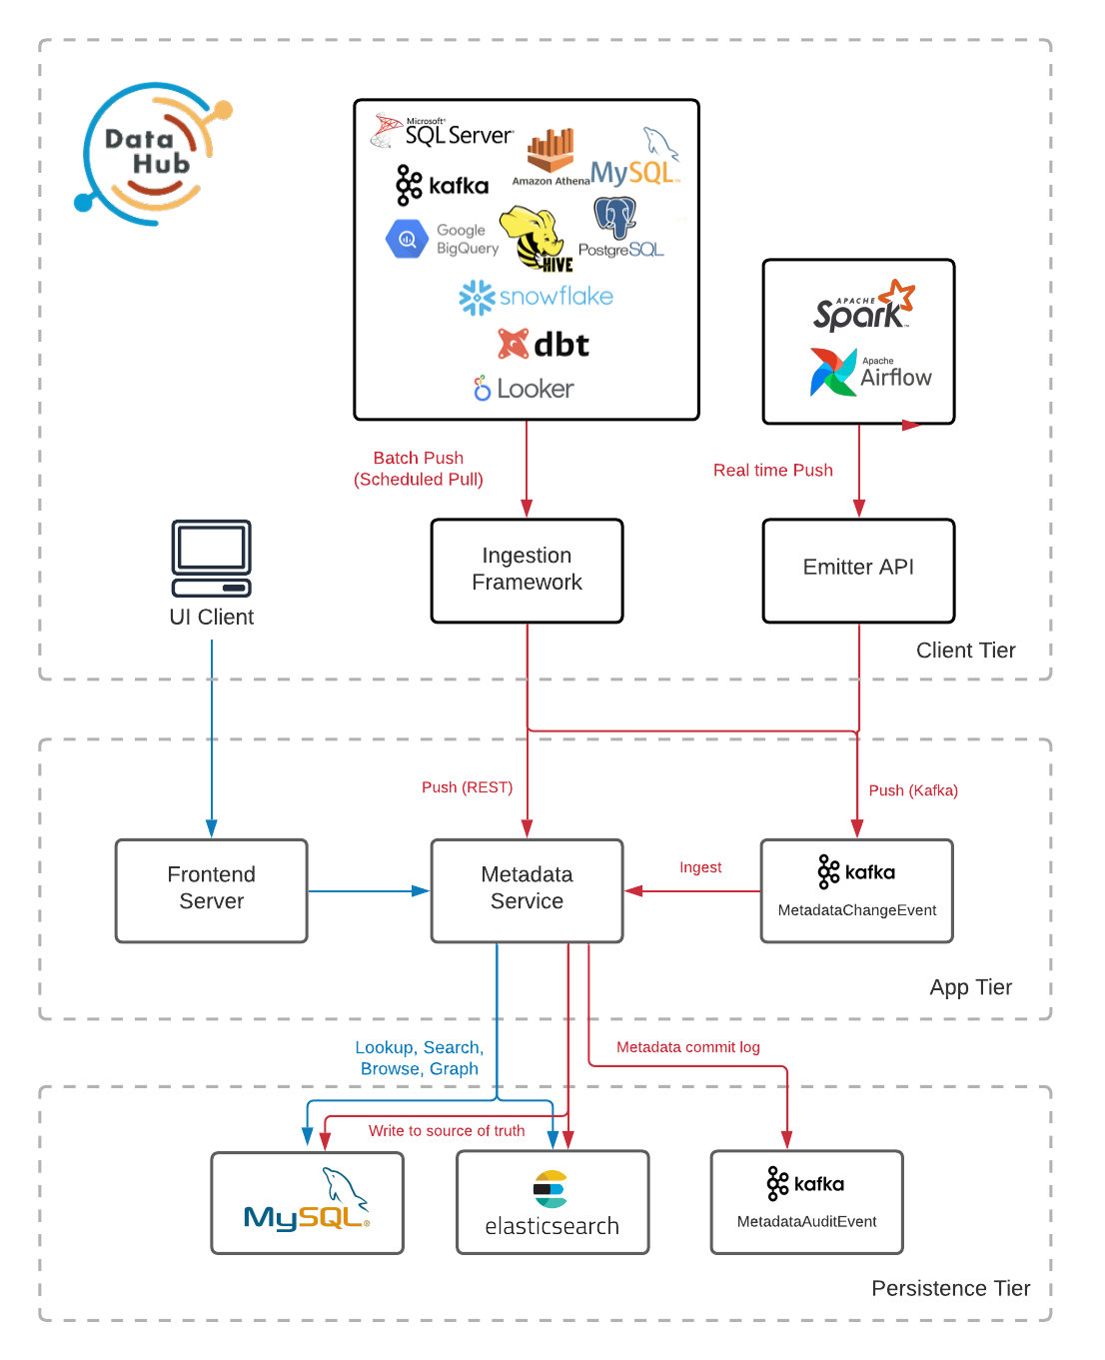
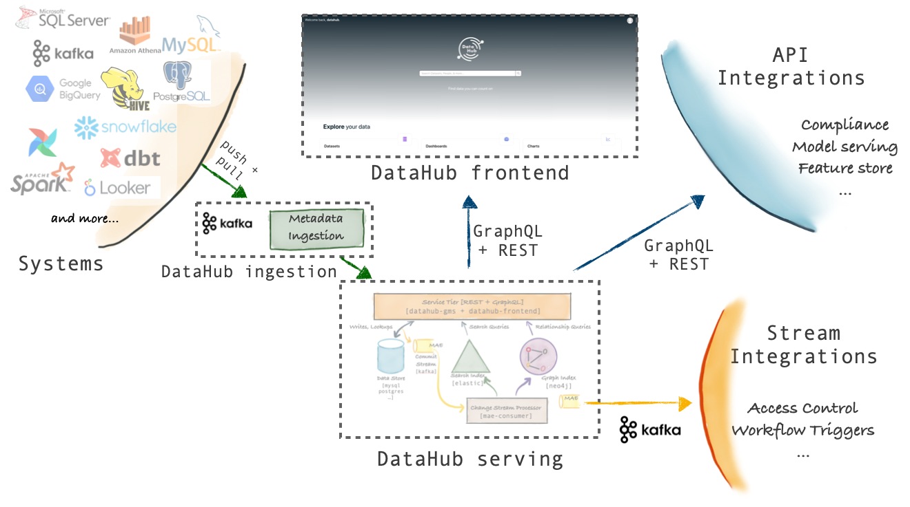
DataHub Architecture
DataHub is a 3rd generation Metadata Platform that enables Data Discovery, Collaboration, Governance, and end-to-end Observability that is built for the Modern Data Stack.

Slide 3
DataHub Architecture Highlights
Schema-first approach to Metadata Modeling
DataHub's metadata model is described using a serialization agnostic language. Both REST as well as GraphQL API-s are supported
DataHub supports an AVRO-based API over Kafka to communicate metadata changes and subscribe to them.
Stream-based Real-time Metadata Platform
DataHub's metadata infrastructure is stream-oriented, which allows for changes in metadata to be communicated and reflected within the platform within seconds
You can also subscribe to changes happening in DataHub's metadata, allowing you to build real-time metadata-driven systems.
Federated Metadata Serving
DataHub comes with a single metadata service (gms) as part of the open source repository
it also supports federated metadata services which can be owned and operated by different teams

Slide 4
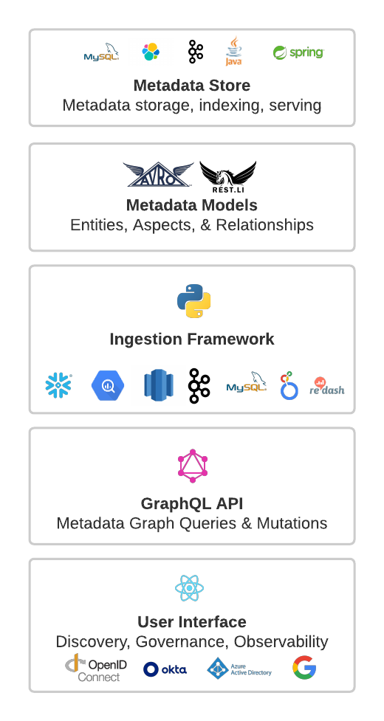
DataHub Components Overview
Metadata Store - responsible for storing the Entities & Aspects comprising the Metadata Graph
Metadata Models - Metadata Models are schemas defining the shape of the Entities & Aspects comprising the Metadata Graph, along with the relationships between them
Ingestion Framework - The Ingestion Framework is a modular, extensible Python library for extracting Metadata from external source systems (e.g. Snowflake, Looker, MySQL, Kafka), transforming it into DataHub's Metadata Model, and writing it into DataHub via either Kafka or using the Metadata Store Rest APIs
GraphQL API - provides a strongly-typed, entity-oriented API that makes interacting with the Entities comprising the Metadata Graph simple, including APIs for adding and removing tags, owners, links & more to Metadata Entities!
User Interface - DataHub comes with a React UI including an ever-evolving set of features to make Discovering, Governing, & Debugging your Data Assets easy.

Slide 5
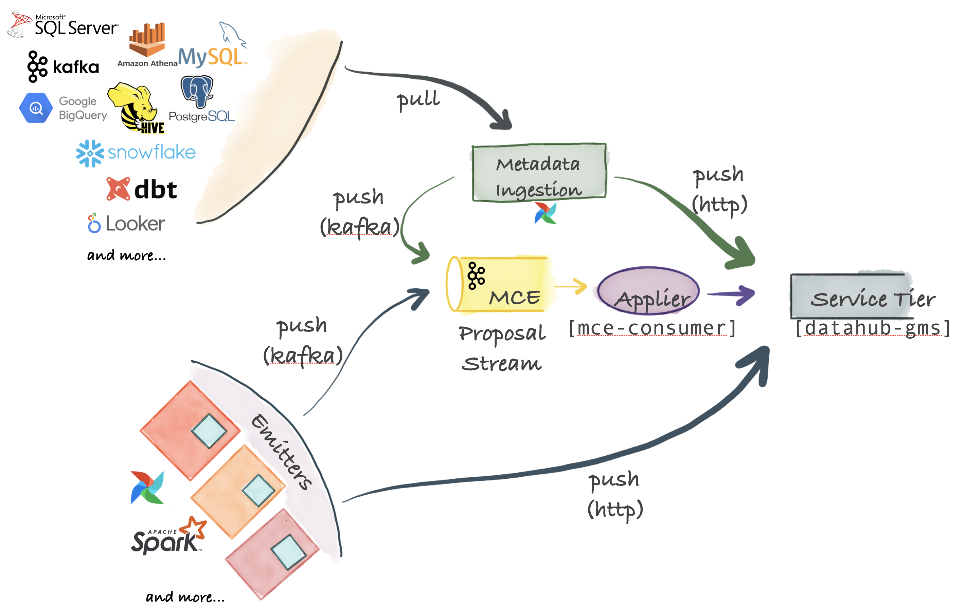
DataHub Ingestion Framework
DataHub supports a flexible ingestion architecture that can support push, pull, asynchronous and synchronous models
The center piece for ingestion are Metadata Change Proposals which represent requests to make a metadata change to an organization's Metadata Graph
Metadata Change Proposals can be sent over Kafka

Slide 6
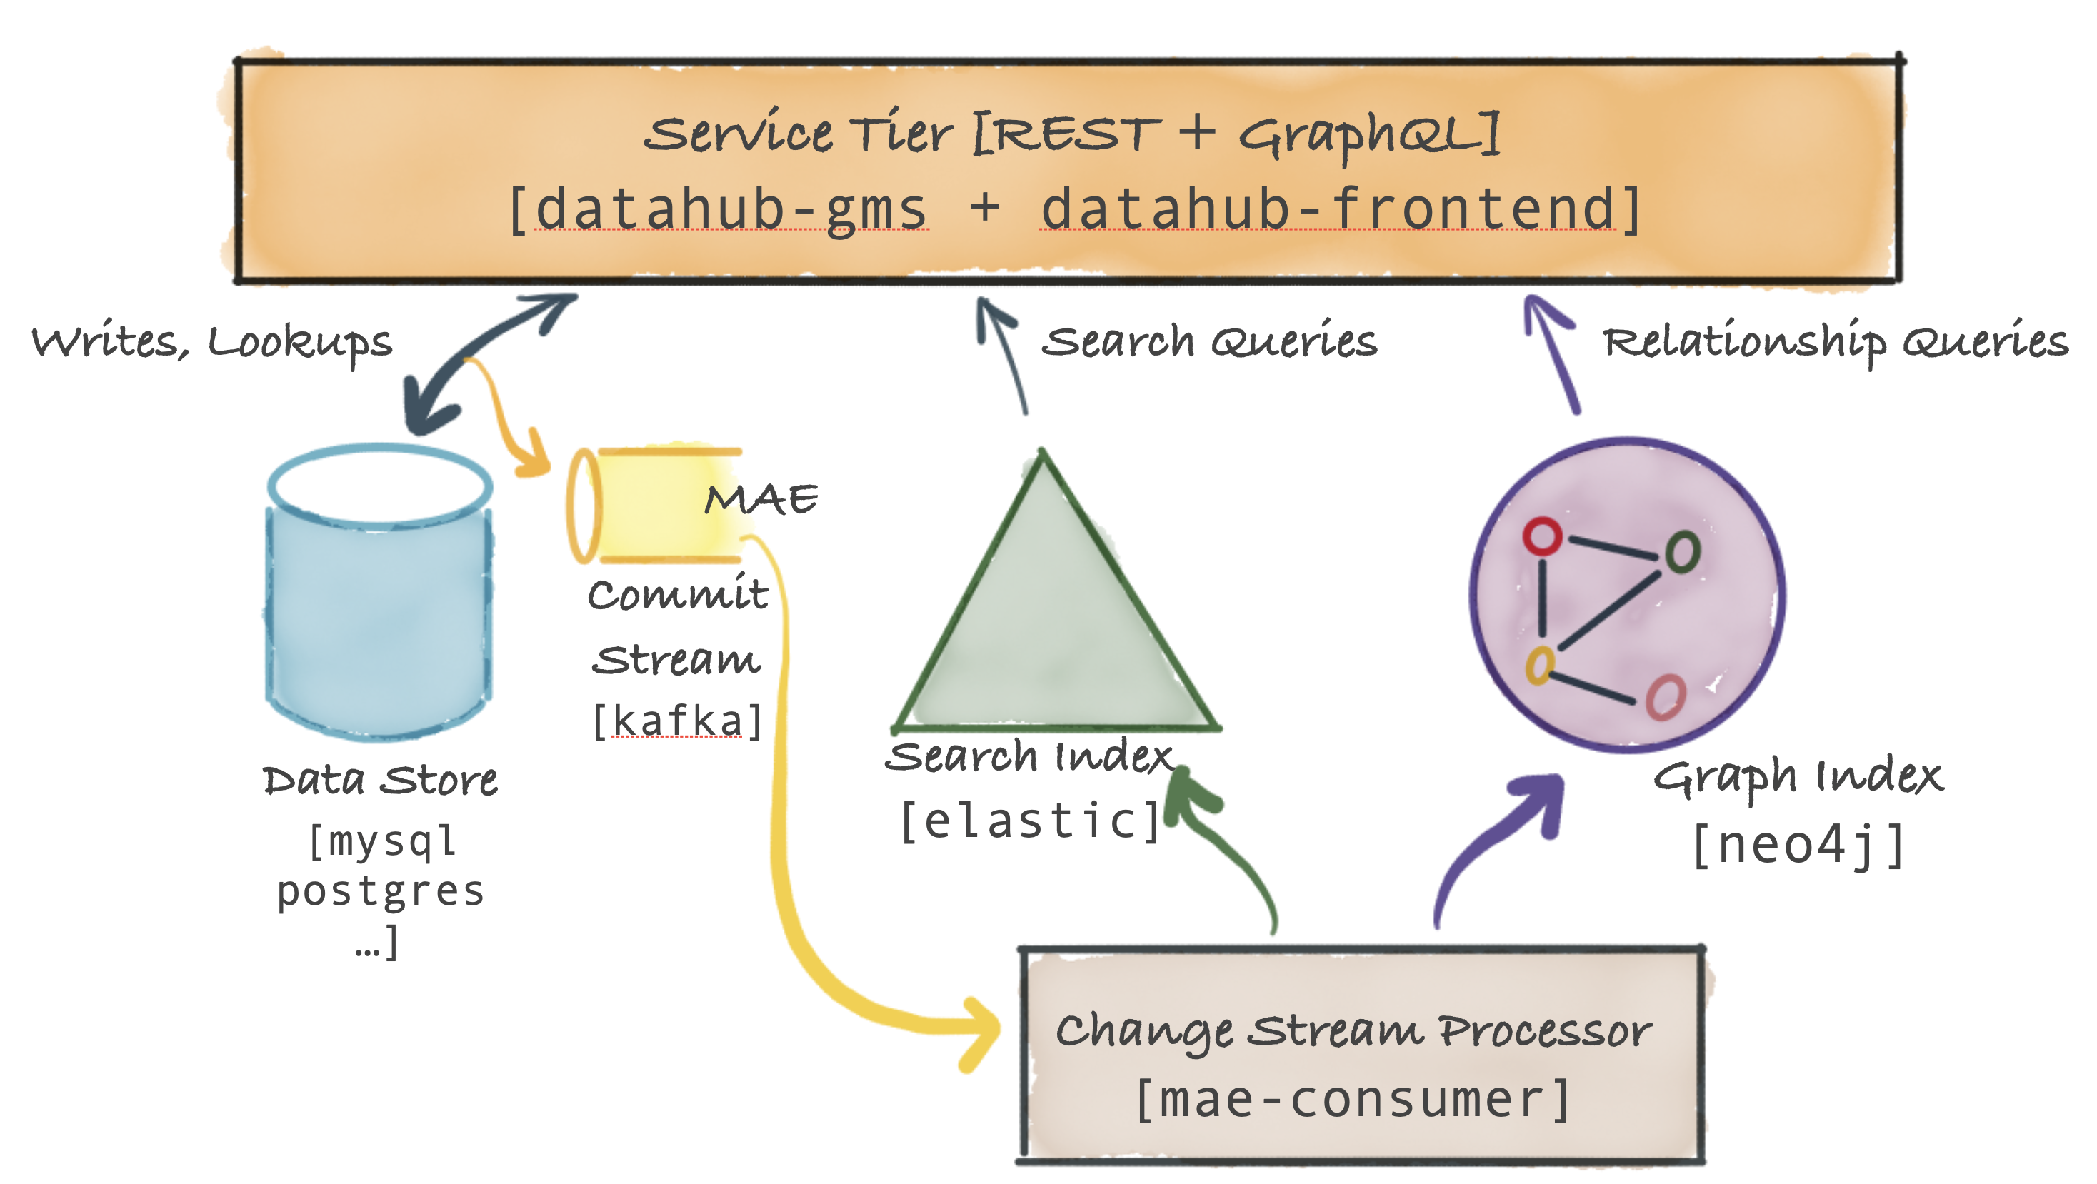
DataHub Serving Architecture
The primary component is called the Metadata Service and exposes a REST API and a GraphQL API for performing CRUD operations on metadata
exposes search and graph query API-s to support secondary-index style queries, full-text search queries as well as relationship queries like lineage
datahub-frontend service expose a GraphQL API on top of the metadata graph

Slide 7
Metadata Change Proposal (MCP)
A Metadata Change Proposal represents a request to change to a specific aspect on an enterprise's Metadata Graph
Each MCP provides a new value for a given aspect.
For example, a single MCP can be emitted to change ownership or documentation or domains or deprecation status for a data asset
Kafka Topic: MetadataChangeProposal_v1 and FailedMetadataChangeProposal_v1
{
"entityType": "dataset",
"entityUrn": "urn:li:dataset:(urn:li:dataPlatform:hdfs,SampleHdfsDataset,PROD)",
"changeType": "UPSERT",
"aspectName": "ownership",
"aspect": {
"value": "{\"owners\":[{\"type\":\"DATAOWNER\",\"owner\":\"urn:li:corpuser:datahub\"}],\"lastModified\":{\"actor\":\"urn:li:corpuser:datahub\",\"time\":1651516640488}}",
"contentType": "application/json"
},
"systemMetadata": {
"lastObserved": 1651516640493,
"runId": "no-run-id-provided",
"registryName": "unknownRegistry",
"registryVersion": "0.0.0.0-dev",
"properties": null
}
}

Slide 8
Metadata Change Log (MCL)
A Metadata Change Log represents any change which has been made to the Metadata Graph. Metadata Change Log events are emitted to Kafka immediately after writing the change the durable storage.
There are 2 flavors of Metadata Change Log: versioned and timeseries.
Versioned aspects are those which represent the "latest" state of some attributes
Timeseries aspects are those which represent events related to an asset that occurred at a particular time
Kafka Topic: MetadataChangeLog_Versioned_v1 and MetadataChangeLog_Timeseries_v1
{
"entityType": "dataset",
"entityUrn": "urn:li:dataset:(urn:li:dataPlatform:hdfs,SampleHdfsDataset,PROD)",
"changeType": "UPSERT",
"aspectName": "ownership",
"aspect": {
"value": "{\"owners\":[{\"type\":\"DATAOWNER\",\"owner\":\"urn:li:corpuser:datahub\"}],\"lastModified\":{\"actor\":\"urn:li:corpuser:datahub\",\"time\":1651516640488}}",
"contentType": "application/json"
},
"previousAspectValue": {
"value": "{\"owners\":[{\"owner\":\"urn:li:corpuser:jdoe\",\"type\":\"DATAOWNER\"},{\"owner\":\"urn:li:corpuser:datahub\",\"type\":\"DATAOWNER\"}],\"lastModified\":{\"actor\":\"urn:li:corpuser:jdoe\",\"time\":1581407189000}}",
"contentType": "application/json"
},
"systemMetadata": {
"lastObserved": 1651516640493,
"runId": "no-run-id-provided",
"registryName": "unknownRegistry",
"registryVersion": "0.0.0.0-dev",
"properties": null
},
"previousSystemMetadata": {
"lastObserved": 1651516415088,
"runId": "file-2022_05_02-11_33_35",
"registryName": null,
"registryVersion": null,
"properties": null
},
"created": {
"time": 1651516640490,
"actor": "urn:li:corpuser:datahub",
"impersonator": null
}
}

Slide 9
Platform Event (PE)
A Platform Event represents an arbitrary business-logic event emitted by DataHub. Each Platform Event has a name which determines its contents.
Kafka topic: PlatformEvent_v1
{
"header": {
"timestampMillis": 1655390732551
},
"name": "entityChangeEvent",
"payload": {
"value": "{\"entityUrn\":\"urn:li:dataset:abc\",\"entityType\":\"dataset\",\"category\":\"OWNER\",\"operation\":\"ADD\",\"modifier\":\"urn:li:corpuser:jdoe\",\"parameters\":{\"ownerUrn\":\"urn:li:corpuser:jdoe\",\"ownerType\":\"BUSINESS_OWNER\"},\"auditStamp\":{\"actor\":\"urn:li:corpuser:jdoe\",\"time\":1649953100653}}",
"contentType": "application/json"
}

Slide 10
Metadata Ingestion
DataHub supports two ways for ingesting metadata:
Push-based - allow you to emit metadata directly from your data systems when metadata changes
Pull-based - allow you to "crawl" or "ingest" metadata from the data systems by connecting to them and extracting metadata in a batch or incremental-batch manner
Examples of push-based integrations include Airflow, Spark, Great Expectations and Protobuf Schemas
Examples of pull-based integrations include BigQuery, Snowflake, Looker, Tableau and many others

Slide 11
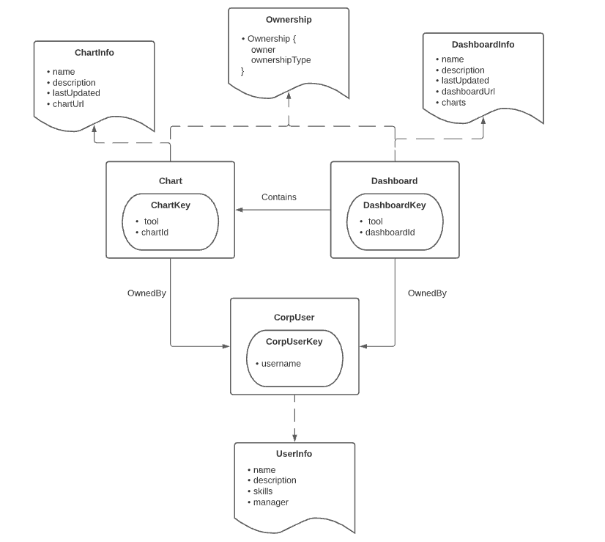
DataHub Metadata Model
Metadata is modeled using the following abstractions
Entities: is the primary node in the metadata graph. An entity is made up of a type, e.g. 'dataset', a unique identifier (e.g. an 'urn') and groups of metadata attributes (e.g. documents) which we call aspects.
Aspects: An aspect is a collection of attributes that describes a particular facet of an entity. They are the smallest atomic unit of write in DataHub. Multiple aspects associated with the same Entity can be updated independently. Aspects can be shared across entities, for example "Ownership" is an aspect that is re-used across all the Entities that have owners.
Relationships: A relationship represents a named edge between 2 entities. They are declared via foreign key attributes within Aspects. Relationships permit edges to be traversed bi-directionally.
Identifiers (Keys & Urns): A key is a special type of aspect that contains the fields that uniquely identify an individual Entity.

Slide 12
DataHub Core Entities
Data Platform - A type of Data "Platform". That is, an external system that is involved in processing, storing, or visualizing Data Assets.
Dataset - collection of data. Tables, Views, Streams, Document Collections, and Files are all modeled as "Datasets" on DataHub. Dataset can have tags, owners, links, glossary terms, description attached.
Chart - single data vizualization derived from a Dataset. A single Chart can be a part of multiple Dashboards. Charts can have tags, owners, links, glossary terms, and descriptions attached.
Dashboard - collection of Charts for visualization. Dashboards can have tags, owners, links, glossary terms, and descriptions attached.
Data Job (Task) - An executable job that processes data assets, where "processing" implies consuming data, producing data, or both. Data Jobs can have tags, owners, links, glossary terms, and descriptions attached
Data Flow (Pipeline) - An executable collection of Data Jobs with dependencies among them, or a DAG. Data Jobs can have tags, owners, links, glossary terms, and descriptions attached.

Slide 13
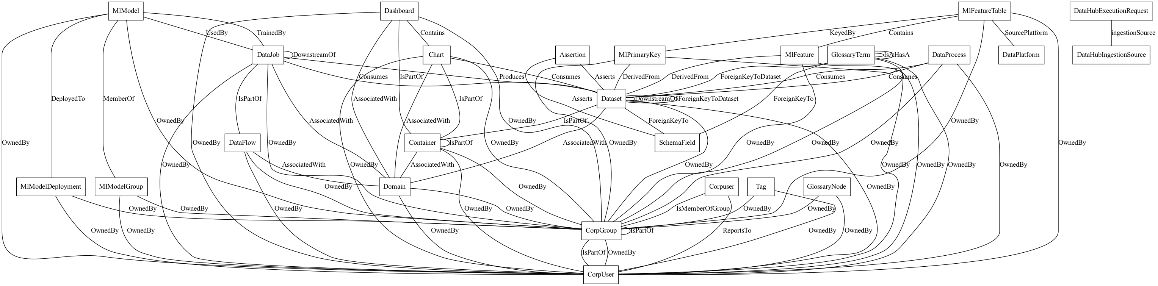
DataHub‘s current Metadata Model
Source: https://datahubproject.io/docs/metadata-modeling/metadata-model#exploring-datahubs-metadata-model

Slide 14
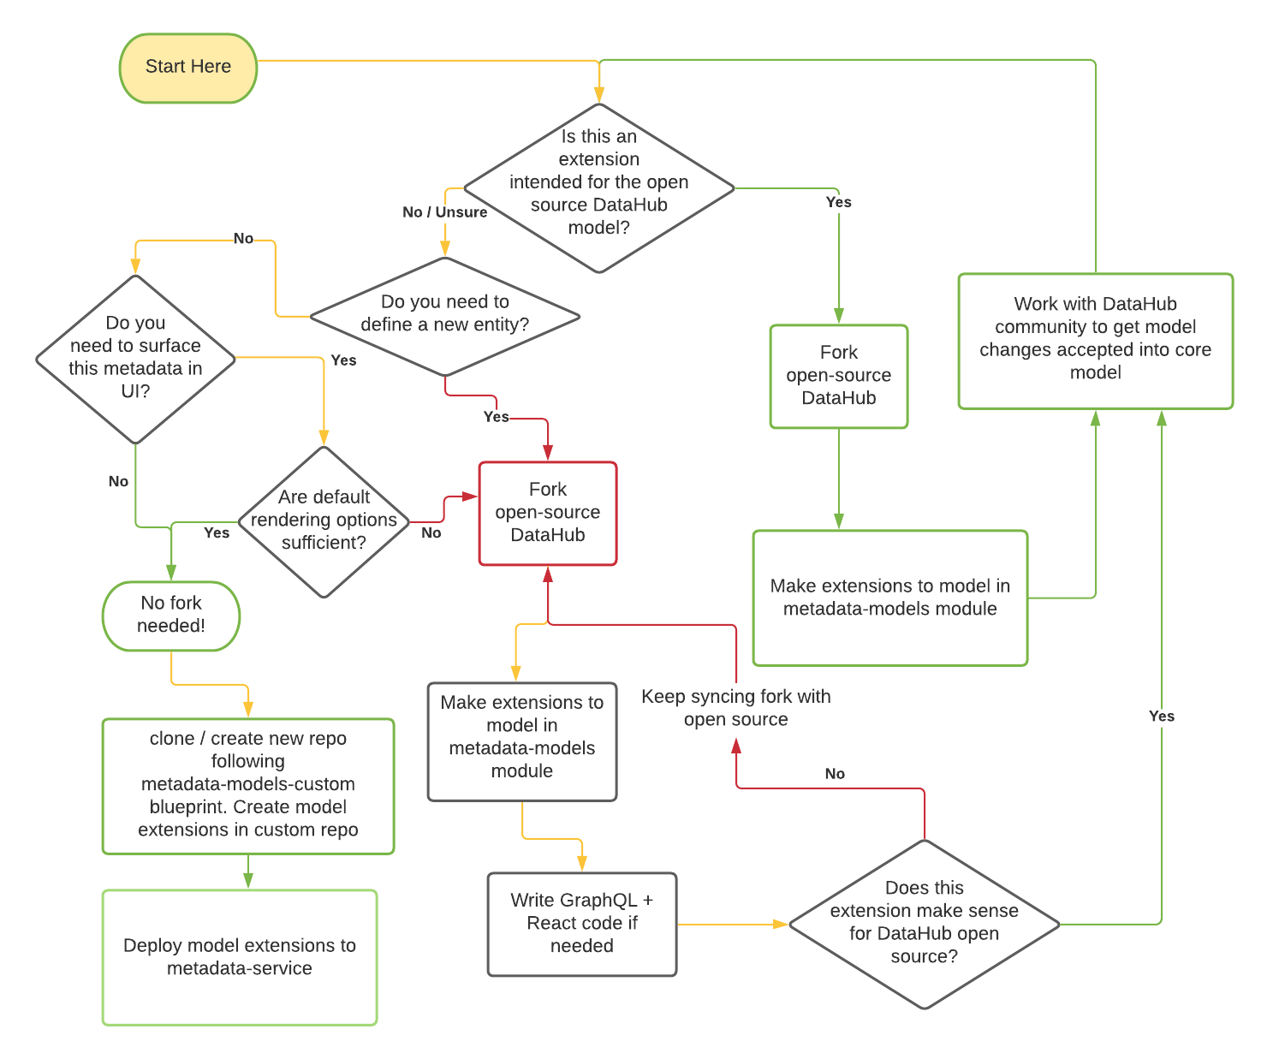
Extending the Metadata Model
You can extend the metadata model by either creating a new Entity or extending an existing one.

Slide 15
Thank You

